Slide 1
Design And Analysis of Algorithms space efficient application for reachability of source to destination in a robot navigation system.
Guided by Dr. Udaya Rani Gurala
By
Jyothin Movva – 2010030071
KS Satyavarsan – 2010030151
Devaraj Achrya – 2010030040
Snehith Kamepalli - 2010030341
KARTHIK – 2010030329

Slide 2
PROBLEM STATEMENT AND DOMAIN
Space - Efficient Algorithms for Reachability in Directed Geometric Graphs
Domain – Graph exploration and implimentations

Slide 3
ABSTRACT
The problem of graph Reachability is to decide whether there is a path from one vertex to another in a given graph
In this project will we try to implement a space efficient algorithm for reachability in directed geometric graph.

Slide 4
LITERATURE REVIEW
Improved Space Efficient Algorithms for BFS, DFS and Applications
(Niranka Banerjee, Sankardeep Chakraborty, Venkatesh Raman)
Abstract- Explores the time and space complexities of BFS and DFS and experiments on the algorithms to improve the relative space complexity.
Space-Efficient Algorithms for Reachability in Geometric Graphs (Sujoy Bhore and Rahul Jain)
Abstract – the paper explains the space related optimizations while maintaining a polynomial time bound.

Slide 5
APPLICATION
The applications will find the shortest path for robot so it can spend less resources reaching that destination.
Since the computers in a mobile robot can be limiting the problem statement objective of using the most space saving algorithm is justified.

Slide 6
EXISTING SOLUTIONS / NAÏVE SOLTIONS
(Existing solution)
(Naïve solution) - Visit every node and mark is as seen and check for adjacent nodes and keep updating the final list.

Slide 7
PROPOSED ALGORITHM AND DESIGN TECHINIQUE
Proposed Technique is using Dijkstras Algorithm.
It is easy to implement with the graph data structure and the time and space complexity is comparable with other solutions.
Prerequisites before implementing the algorithm
Visiting the nodes
Exploration of nodes
Depth first search algorithm and functionality
Time complexity – O(logV)
Space complexity - O(V) .

Slide 8
DATA STRUCTURES
Graph data structure
Python – dictionary

Slide 9
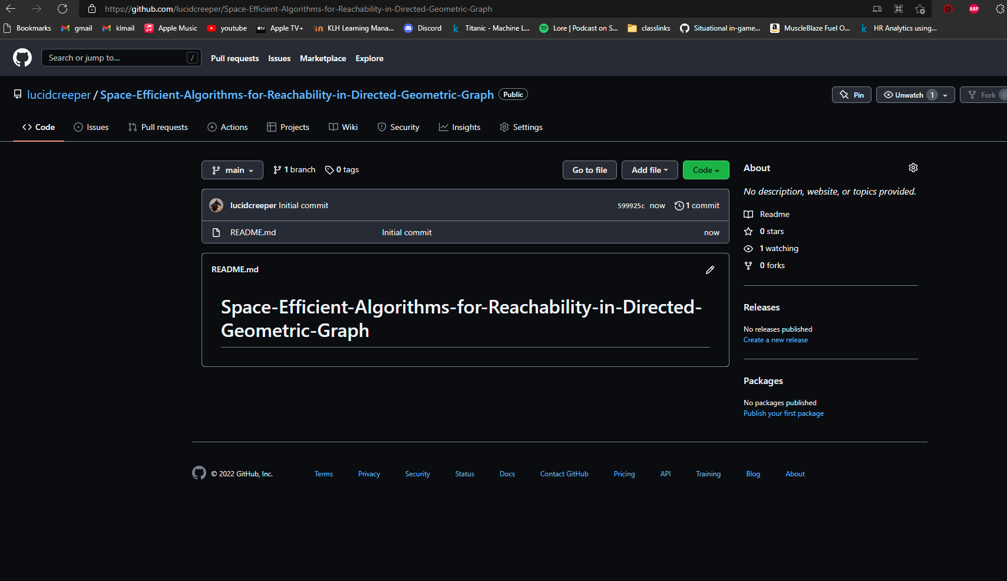
GITHUB SETUP
lucidcreeper/Space-Efficient-Algorithms-for-Reachability-in-Directed-Geometric-Graph (github.com)

Slide 10
DIVISION OF WORK
Implementation – Jyothin, Satya
Algorithm and logic – Jyothin, Snehith, Karthik
Testing and functionality – Devaraj

Slide 11
Suggestions

Slide 12
Thank you

